Slide 1
Importance of Personal and Professional Relationships
Presented by Samanway Sahoo

Slide 2
What is Relationship ?
Relations between human being
Affected by many other factors
Help in accomplishment of personal or organizational goals.

Slide 3
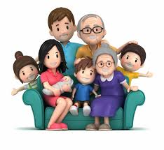
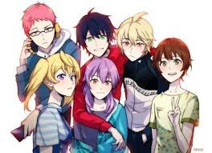
Personal Relationship
Close connections between people
Formed by emotional bonds and interaction
Examples

Slide 4
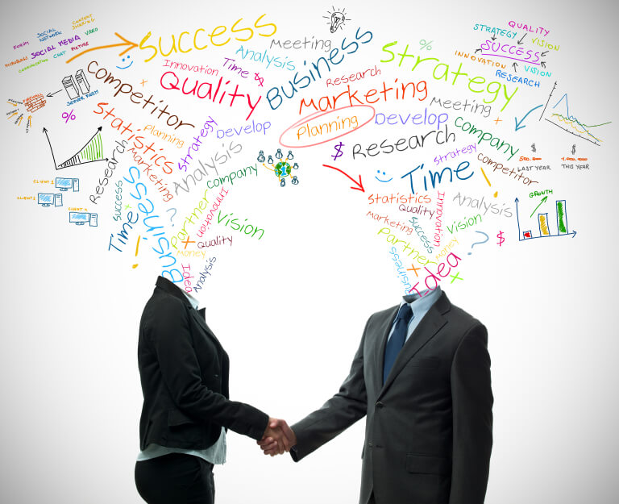
Professional Relationship
Treasured relationship
To grow in career
Needs to be handled in different way
If needs, end in a positive way.
Don’t burn the bridge

Slide 5
Comparison between Professional and Personal Relationship
Personal Relationship | Professional Relationship
We value the connection, spends time, care and wants best for each other | Even if you genuinely like other person, still the ultimate goal is to progress in career

Slide 6
Comparison between Professional and Personal Relationship
Personal Relationship | Professional Relationship
We value the connection, spends time, care and wants best for each other | Even if you genuinely like other person, still the ultimate goal is to progress in career
Grows out of basic human needs for love, connection and belonging | Grows for service in our professional goals

Slide 7
Comparison between Professional and Personal Relationship
Personal Relationship | Professional Relationship
We value the connection, spends time, care and wants best for each other | Even if you genuinely like other person, still the ultimate goal is to progress in career
Grows out of basic human needs for love, connection and belonging | Grows for service in our professional goals
Our pride is at risk | Our livelihood is at risk

Slide 8
Comparison between Professional and Personal Relationship
Personal Relationship | Professional Relationship
We value the connection, spends time, care and wants best for each other | Even if you genuinely like other person, still the ultimate goal is to progress in career
Grows out of basic human needs for love, connection and belonging | Grows for service in our professional goals
Our pride is at risk | Our livelihood is at risk
We want to be open and straight forward, we want to be appreciated for who we are | We need to be more strategic

Slide 9
Thank You

